Slide 1
United Way Presentation

Slide 2
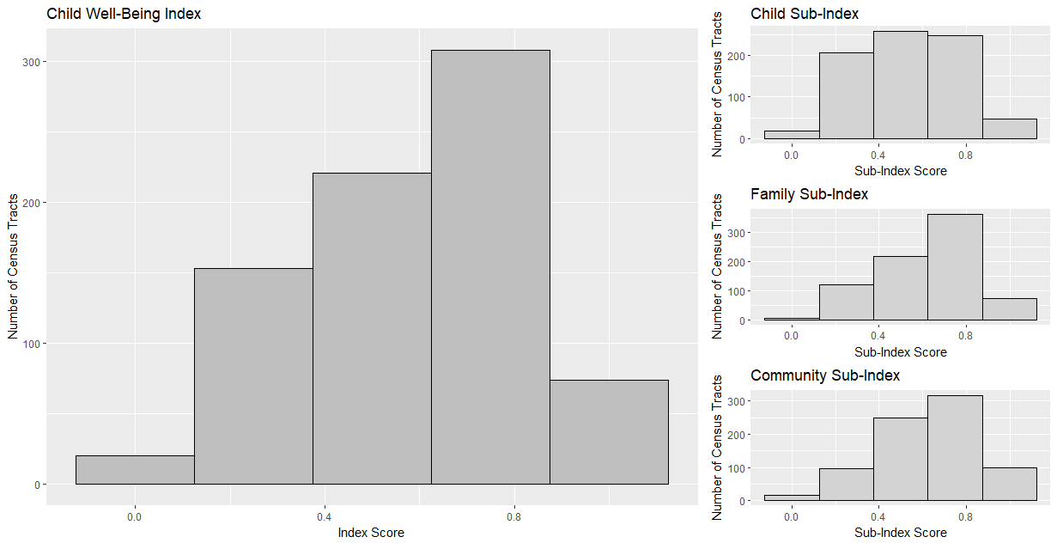
Results: Barplots

Slide 3
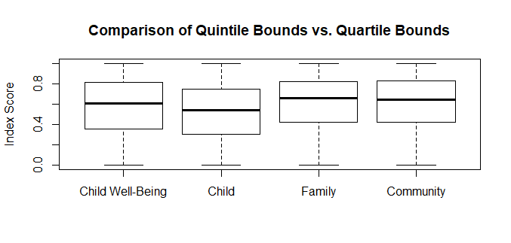
Results: Box-Plots
Notes:
These were not effective

Slide 4
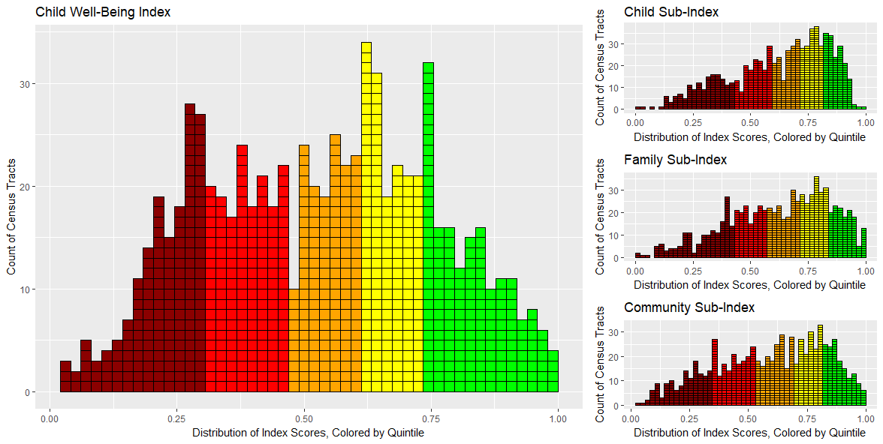
Results: Histogram Plot

Slide 5
Results: Histogram Plot

Slide 6
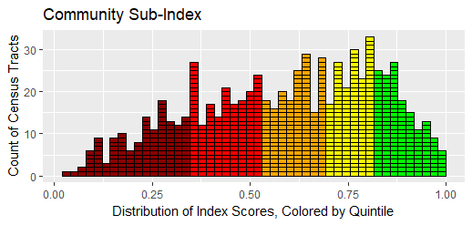
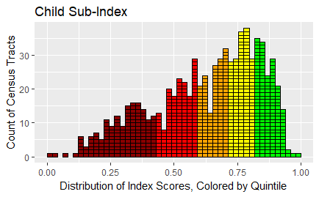
Results: SUB-indices
Community Sub-index
Child Sub-index

Slide 7
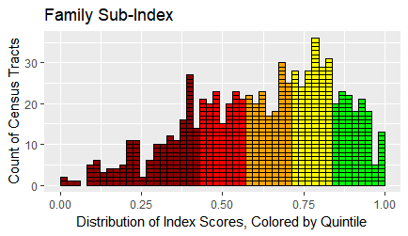
Results: SUB-indices
Community Sub-index
Family Sub-index

Slide 8
Future Exploration

